Slide 1
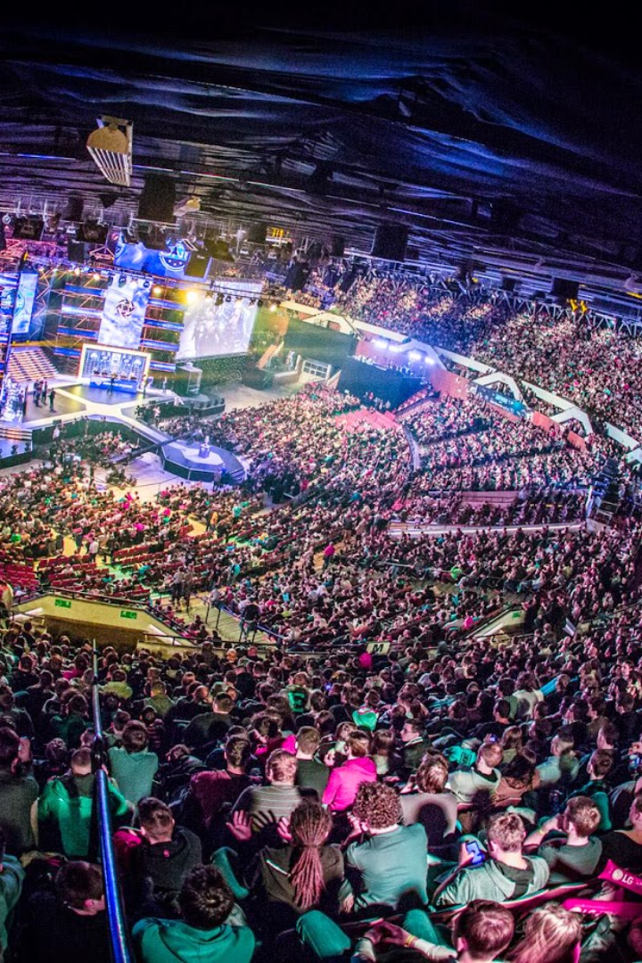
Introduction
In today's world, the rise of esports, a term derived from "e-sports," is generating a lot of interest and exciting for many people. With the constant advances in technology, gaming has crossed its traditional boundaries and become a major player in shaping modern society, from culture and economy to education.
Prepared by O. Holovnya from IP-11.

Slide 2
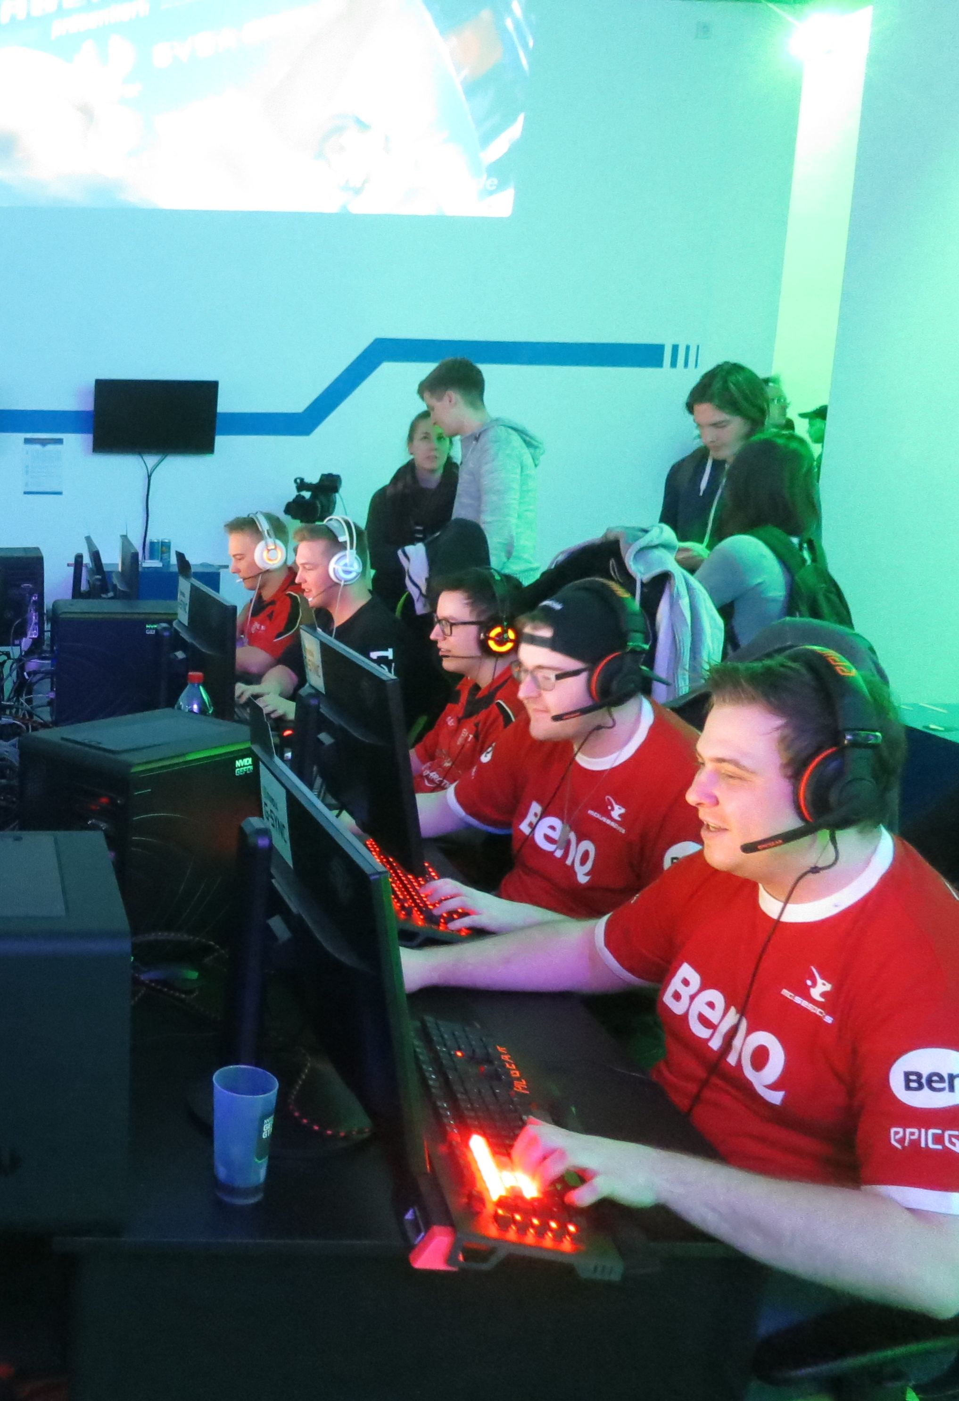
What is esports?
Esports is a phenomenon that is rapidly gaining worldwide popularity and recognition as a serious form of sport. The term "esports" comes from the combination of the words "cybernetics" and "sport", which indicates that it is an activity that takes place in an electronic, virtual environment, but requires a high level of skill, strategic thinking and coordination from participants.
Esports has developed in its own unique way, starting as a hobby for video game players and evolving into a large-scale industry where professional players compete on a level playing field with athletes in traditional sports.
The sport connects millions of fans and players around the world, creating its own culture and raising the standard of competition.

Slide 3
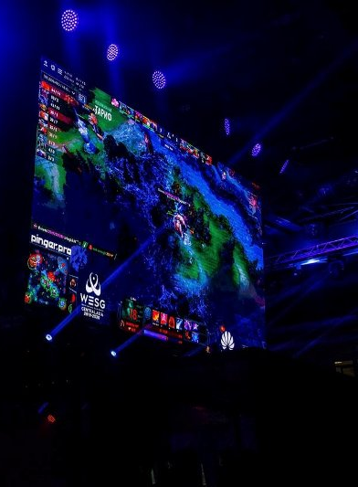
The globalization of esports
Growth and globalization of esports
Over the past decades, esports has passed through a significant evolution, moving from local tournaments to becoming a global phenomenon with large-scale international competitions. Today, these events bring together players from all over the world, creating a special intercultural environment.

Slide 4
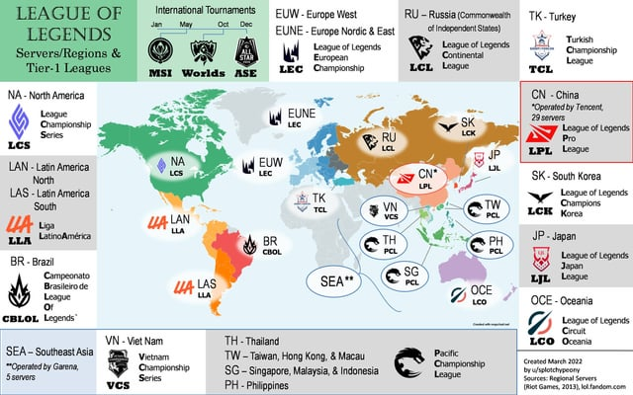
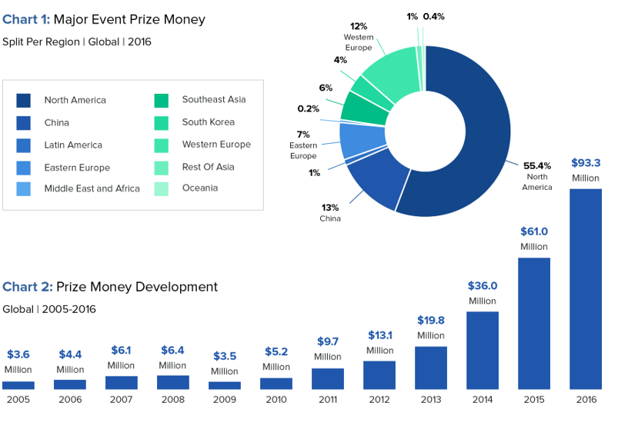
Economic impact of esports
Illustration 2 - A world map showing the locations of major esports events from the game League of Legends.
Illustration 1 - Graphs showing the growth dynamics of prize pools and investments in esports in recent years.

Slide 5
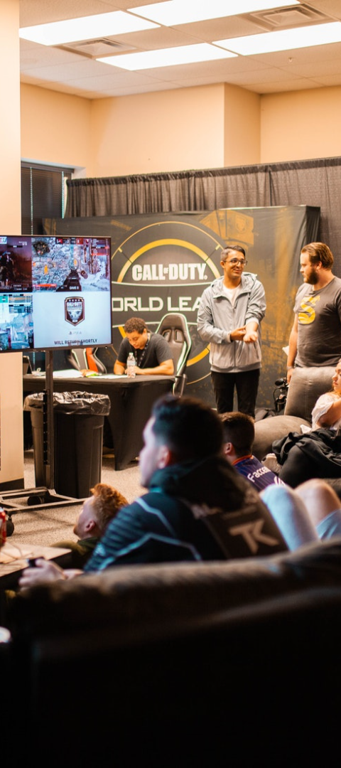
Social and cultural impact of esports
Esports community
Fans become part of a large online community where they discuss and share their impressions of the game. This also helps to create new traditions, holidays and rituals.

Slide 6
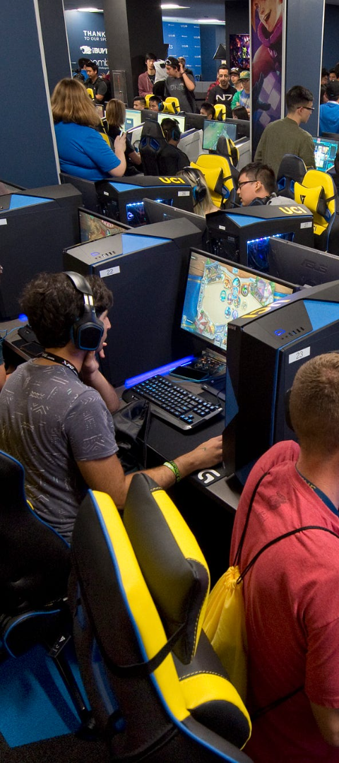
Esports and education
Development of educational programs related to esports
The training programs cover not only aspects of the game, but also analytics, coaching, and management, preparing young people for a professional challenge in this field.

Slide 7
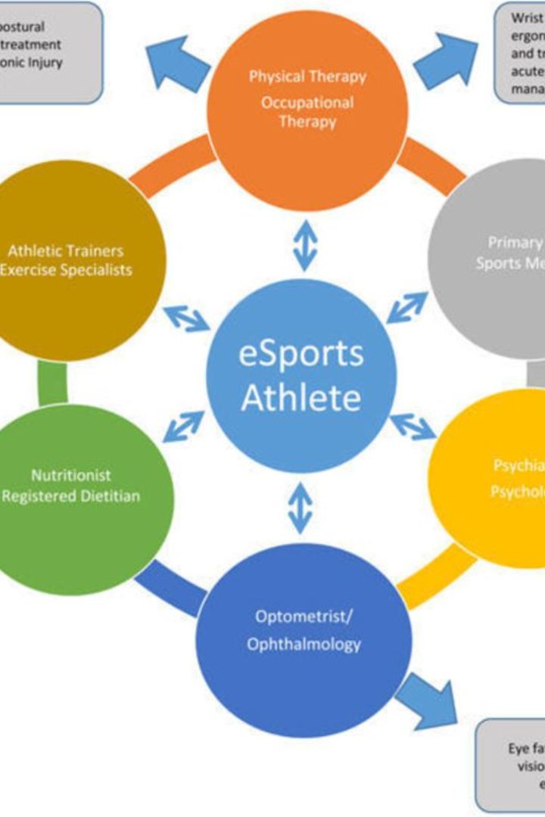
Health and wellness in esports
The importance of the physical and mental health of players is always in the first place,
because it can affect the players' performance directly

Slide 8
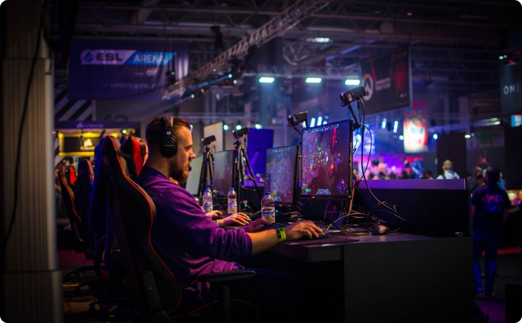
Future trends in esports
Technological achievements
The development of new technologies, more efficient tournaments, and new game formats are expanding the esports industry.

Slide 9
Thank you!

